Slide 1
并行程序设计导论 CUDA 程序分析
Ying Yu
04/29/2022
yingyu@nju.edu.cn

Slide 2
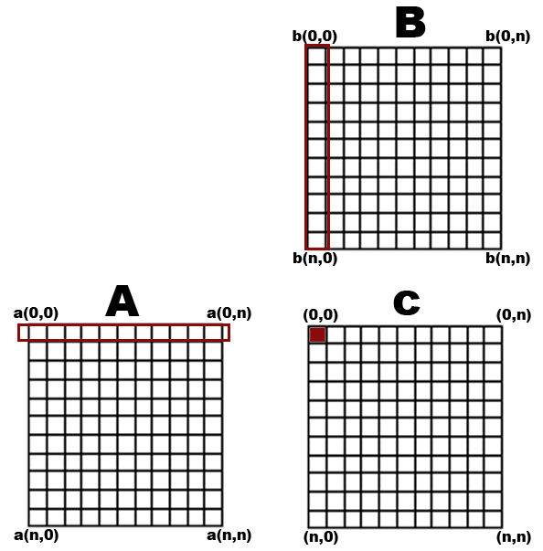
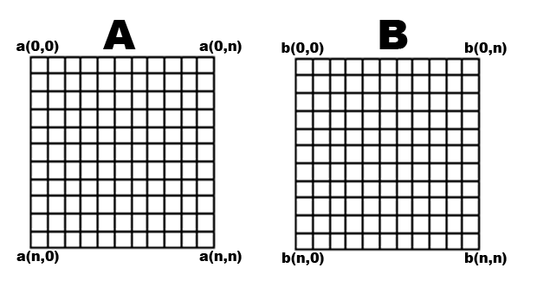
Matrix-Matrix Operations
Store matrices as 2D textures
Express multiplication of two matrices
as dot product of vector of matrix row and columns
Compute matrix C by:
for each cell of cij take the dot product of row I of
matrix A with column j of matrix B

Slide 3


Matrix Multiply Operations
Matrix Multiplication Review
So in other words we have:
In general:
(AB)_{ij} = ∑_{r=0} a_{ir} b_{rj}
Naïve O(n³) CPU algorithm
for i = 1 to n
for j = 1 to n
C[i,j] = ∑ A[I,k] * B[k,j]

Slide 4

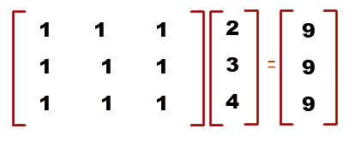
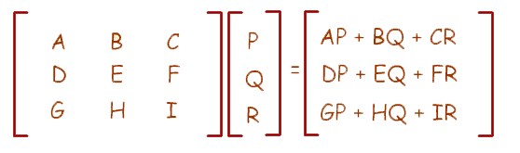
Matrix-Matrix Operations
Matrix Vector Operation Review
Example 1:
Example 2:

Slide 5
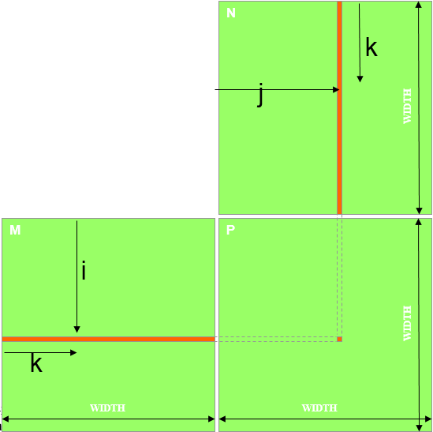
Matrix Multiply Example
P = M * N of size WIDTH x WIDTH
Without tiling:
– One thread calculates one element of P
– M and N are loaded WIDTH times from global memory
Image from: http://courses.engr.illinois.edu/ece498/al/textbook/Chapter2-CudaProgrammingModel.pdf

Slide 6
Matrix Multiply Sample
100 X 100 matrices
- 10000 independent dot products
- Each dot product involves 100 multiply and 100 accumulate --arithmetic operations
One thread could be used to compute one P element which would generate 10000 threads
Very large amount of data parallelism
By executing many dot products in parallel, a GPU device can significantly accelerate the execution of the matrix multiplication

Slide 7
Matrix Multiply: Naïve Host Code
void MatrixMulOnHost(float* M, float* N, float* P, int width)‏
{
for (int i = 0; i < width; ++i)‏
for (int j = 0; j < width; ++j)
{
float sum = 0;
for (int k = 0; k < width; ++k)
{
float a = M[i * width + k];
float b = N[k * width + j];
sum += a * b;
}
P[i * width + j] = sum;
}
}
Code from: http://courses.engr.illinois.edu/ece498/al/lectures/lecture3%20cuda%20threads%20spring%202010.ppt

Slide 8
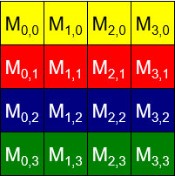
Memory Layout of a Matrix in C
M

Slide 9
Matrix Multiply : Outline
Int main（void）{
1. // Allocate and initialize the matrices M,N,P
// I/O to read the input matrices M and N
2. // M * N on the device
MatrixMulOnDevice(M,N,P,width);
3. // I/O to write the output matrix P
// Free matrices M,N,P
Return 0;
}
Code from: http://courses.engr.illinois.edu/ece498/al/textbook/Chapter2-CudaProgrammingModel.pdf

Slide 10
Matrix Multiply : Outline
Int main（void）{
1. // Allocate and initialize the matrices M,N,P
// I/O to read the input matrices M and N
2. // M * N on the device
MatrixMulOnDevice(M,N,P,width);
3. // I/O to write the output matrix P
// Free matrices M,N,P
Return 0;
}
Code from: http://courses.engr.illinois.edu/ece498/al/textbook/Chapter2-CudaProgrammingModel.pdf

Slide 11
Matrix Multiply: CUDA 算法框架
第1步
在算法框架中添加 CUDA memory transfers

Slide 12
Matrix Multiply : Input Matrix Data Transfer (Host-side Code)
void MatrixMulOnDevice(float* M, float* N, float* P, int Width)‏
{
int size = Width * Width * sizeof(float);
float* Md, Nd, Pd;
…
1. // Allocate and Load M, N to device memory
cudaMalloc(&Md, size);
cudaMemcpy(Md, M, size, cudaMemcpyHostToDevice);
cudaMalloc(&Nd, size);
cudaMemcpy(Nd, N, size, cudaMemcpyHostToDevice);
// Allocate P on the device
cudaMalloc(&Pd, size);
分配输入
Code from: http://courses.engr.illinois.edu/ece498/al/textbook/Chapter2-CudaProgrammingModel.pdf

Slide 13
Matrix Multiply : Input Matrix Data Transfer (Host-side Code)
void MatrixMulOnDevice(float* M, float* N, float* P, int Width)‏
{
int size = Width * Width * sizeof(float);
float* Md, Nd, Pd;
…
1. // Allocate and Load M, N to device memory
cudaMalloc(&Md, size);
cudaMemcpy(Md, M, size, cudaMemcpyHostToDevice);
cudaMalloc(&Nd, size);
cudaMemcpy(Nd, N, size, cudaMemcpyHostToDevice);
// Allocate P on the device
cudaMalloc(&Pd, size);
分配输出
Code from: http://courses.engr.illinois.edu/ece498/al/textbook/Chapter2-CudaProgrammingModel.pdf

Slide 14
Matrix Multiply : Input Matrix Data Transfer (Host-side Code)
2. // Kernel invocation code – to be shown later
…
3. // Read P from the device
cudaMemcpy(P, Pd, size, cudaMemcpyDeviceToHost);
// Free device matrices
cudaFree(Md); cudaFree(Nd); cudaFree (Pd);
}
Code from: http://courses.engr.illinois.edu/ece498/al/textbook/Chapter2-CudaProgrammingModel.pdf

Slide 15
Matrix Multiply Sample
第3步 CUDA C编程 kernel
A CUDA kernel is executed by an array of threads
-- All threads run the same code (SPMD)‏
-- Each thread has an ID that it uses to compute memory addresses and make control decisions
threadID
0
1
2
3
4
5
6
7
…
float x = input[threadID];
float y = func(x);
output[threadID] = y;
…

Slide 16
Matrix Multiply Sample
Divide monolithic thread array into multiple blocks
Threads within a block cooperate via shared memory, atomic operations and barrier synchronization
Threads in different blocks cannot cooperate
Thread Block 0
Thread Block 1
Thread Block 2
threadID
0
1
2
3
4
5
6
7
threadID
0
1
2
3
4
5
6
7
threadID
0
1
2
3
4
5
6
7
…
float x = input[threadID];
float y = func(x);
output[threadID] = y;
…
…
float x = input[threadID];
float y = func(x);
output[threadID] = y;
…
…
float x = input[threadID];
float y = func(x);
output[threadID] = y;
…

Slide 17
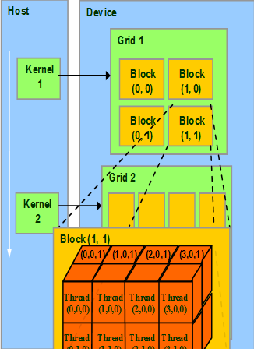

Matrix Multiply Sample
第3步 CUDA C编程 kernel
Each thread uses IDs to decide what data to work on
Block ID: 1D or 2D
Thread ID: 1D, 2D, or 3D
Simplifies memory addressing when processing
multidimensional data
Image processing
Solving PDEs on volumes

Slide 18
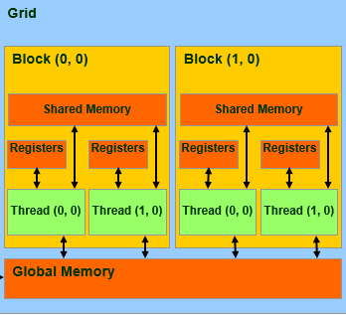

Global memory
Main means of communicating R/W Data between host and device
Contents visible to all threads
Long latency access

Slide 19
Cuda Thread ID Keywords
All threads execute the same kernel code
There needs to be a mechanism to allow them to direct themselves towards the particular parts of the data structure they are designated to work on.
Keywords “threadIdx.x” and “threadIdx.y” refer to the thread indices of a thread
allow a thread to access hardware registers associated with it at runtime that provides the identity to the thread.
We will refer to a thread as Thread threadIdx.x, threadIdx.y

Slide 20
Matrix Multiply: CUDA Kernel
// Matrix multiplication kernel – per thread code
__global__ void MatrixMulKernel(float* Md, float* Nd, float* Pd, int Width)‏
{
// 2D Thread ID
int tx = threadIdx.x;
int ty = threadIdx.y;
// Pvalue is used to store the element of the matrix
// that is computed by the thread
float Pvalue = 0;
访问一个matrix, 所以采用二维block
每个 kernel 线程计算一个输出
Code from: http://courses.engr.illinois.edu/ece498/al/textbook/Chapter2-CudaProgrammingModel.pdf

Slide 21
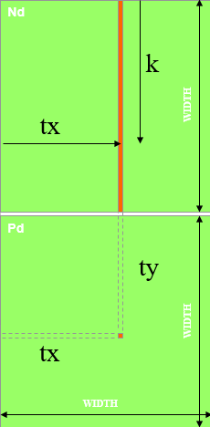
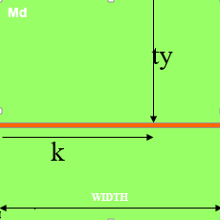
Matrix Multiply: CUDA Kernel
for (int k = 0; k < Width; ++k)‏ {
float Melement = Md[ty*Width+k];
float Nelement = Nd[k*Width+ tx];
Pvalue += Melement * Nelement;
}
Pd[ty*Width+ tx] = Pvalue;
}
Code from: http://courses.engr.illinois.edu/ece498/al/textbook/Chapter2-CudaProgrammingModel.pdf

Slide 22
Kernel Invocation(Host-side Code)
// Setup the execution configuration
dim3 dimGrid(1, 1);
dim3 dimBlock(Width, Width);
// Launch the device computation threads!
MatrixMulKernel<<<dimGrid, dimBlock>>>(Md, Nd, Pd, Width);

Slide 23
Matrix Multiply Sample
Nd
一个线程block计算Pd
每个线程计算Pd的一个元素
每个线程
读入矩阵Md的一行
读入矩阵Nd的一列
为每对Md和Nd元素执行一次乘法和加法
计算次数和片外访存次数比率接近1:1
矩阵的长度受限于一个线程块允许的线程数目
Grid 1
Block 1
Thread
(2, 2)‏
48
WIDTH
Md
Pd
Slide from: http://courses.engr.illinois.edu/ece498/al/lectures/lecture2%20cuda%20spring%2009.ppt

Slide 24
Matrix Multiply Sample, perfect code
What is the main limitation?

Slide 25
我们来重新分析
matrix multiply

Slide 26
Matrix Multiply: CPU 实现
void MatrixMulOnHost(float* M, float* N, float* P, int width)‏
{
for (int i = 0; i < width; ++i)‏
for (int j = 0; j < width; ++j)
{
float sum = 0;
for (int k = 0; k < width; ++k)
{
float a = M[i * width + k];
float b = N[k * width + j];
sum += a * b;
}
P[i * width + j] = sum;
}
}
Code from: http://courses.engr.illinois.edu/ece498/al/lectures/lecture3%20cuda%20threads%20spring%202010.ppt

Slide 27
Matrix Multiply: CUDA Kernel
// Matrix multiplication kernel – per thread code
__global__ void MatrixMulKernel(float* Md, float* Nd, float* Pd, int Width)‏
{
// 2D Thread ID
int tx = threadIdx.x;
int ty = threadIdx.y;
// Pvalue is used to store the element of the matrix
// that is computed by the thread
float Pvalue = 0;
访问一个matrix, 所以采用二维block
每个 kernel 线程计算一个输出
Code from: http://courses.engr.illinois.edu/ece498/al/textbook/Chapter2-CudaProgrammingModel.pdf

Slide 28
Matrix Multiply: CUDA Kernel
for (int k = 0; k < Width; ++k)‏ {
float Melement = Md[ty*Width+k];
float Nelement = Nd[k*Width+ tx];
Pvalue += Melement * Nelement;
}
Pd[ty*Width+ tx] = Pvalue;
}
Code from: http://courses.engr.illinois.edu/ece498/al/textbook/Chapter2-CudaProgrammingModel.pdf

Slide 29
Limitation of One Block

Slide 30
Have each 2D thread block to compute a (TILE_WIDTH) x (TILE_WIDTH) sub-matrix(tile) of the result matrix - each has (TILE_WIDTH) x (TILE_WIDTH) threads
Generate a 2D Grid of (WIDTH/TILE_WIDTH)x(WIDTH/TILE_WIDTH) blocks
bx
0
1
2
tx
0
TILE_WIDTH-1
1
2
Nd
TILE_WIDTH
WIDTH
TILE_WIDTH
Md
Pd
0
0
Pd_{sub}
1
ty
2
WIDTH
by
1
TILE_WIDTHE
TILE_WIDTH-1
TILE_WIDTH
TILE_WIDTH
TILE_WIDTH
2
WIDTH
Image from http://courses.engr.illinois.edu/ece498/al/textbook/Chapter3-CudaThreadingModel.pdf
WIDTH

Slide 31
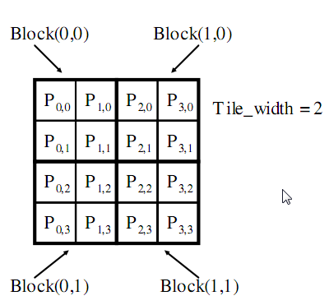
Example
Matrix : 4x4
TILE_WIDTH = 2
Block size: 2x2
Image from http://courses.engr.illinois.edu/ece498/al/textbook/Chapter3-CudaThreadingModel.pdf

Slide 32
Nd_{0,0}
Nd_{1,0}
Matrix : 4x4
TILE_WIDTH = 2
Block size: 2x2
Nd_{0,1}
Nd_{1,1}
Nd_{0,2}
Nd_{1,2}
Nd_{0,3}
Nd_{1,3}
Md_{0,0}
Md_{1,0}
Md_{2,0}
Md_{3,0}
Pd_{0,0}
Pd_{1,0}
Pd_{2,0}
Pd_{3,0}
Md_{0,1}
Md_{1,1}
Md_{2,1}
Md_{3,1}
Pd_{0,1}
Pd_{1,1}
Pd_{2,1}
Pd_{3,1}
Pd_{0,2}
Pd_{1,2}
Pd_{2,2}
Pd_{3,2}
Pd_{0,3}
Pd_{1,3}
Pd_{2,3}
Pd_{3,3}
Image from http://courses.engr.illinois.edu/ece498/al/Syllabus.html

Slide 33
__global__ void MatrixMulKernel(
float* Md, float* Nd, float* Pd, int Width)
{
int Row = blockIdx.y * blockDim.y + threadIdx.y;
int Col = blockIdx.x * blockDim.x + threadIdx.x;
float Pvalue = 0;
for (int k = 0; k < Width; ++k)
Pvalue += Md[Row * Width + k] * Nd[k * Width + Col];
Pd[Row * Width + Col] = Pvalue;
}
Code from http://courses.engr.illinois.edu/ece498/al/Syllabus.html

Slide 34
计算矩阵Pd 和M的行索引
__global__ void MatrixMulKernel(
float* Md, float* Nd, float* Pd, int Width)
{
int Row = blockIdx.y * blockDim.y + threadIdx.y;
int Col = blockIdx.x * blockDim.x + threadIdx.x;
float Pvalue = 0;
for (int k = 0; k < Width; ++k)
Pvalue += Md[Row * Width + k] * Nd[k * Width + Col];
Pd[Row * Width + Col] = Pvalue;
}
Code from http://courses.engr.illinois.edu/ece498/al/Syllabus.html

Slide 35
计算矩阵Pd 和N的列索引
__global__ void MatrixMulKernel(
float* Md, float* Nd, float* Pd, int Width)
{
int Row = blockIdx.y * blockDim.y + threadIdx.y;
int Col = blockIdx.x * blockDim.x + threadIdx.x;
float Pvalue = 0;
for (int k = 0; k < Width; ++k)
Pvalue += Md[Row * Width + k] * Nd[k * Width + Col];
Pd[Row * Width + Col] = Pvalue;
}
Code from http://courses.engr.illinois.edu/ece498/al/Syllabus.html

Slide 36
每个线程计算块内子矩阵的一个元素
__global__ void MatrixMulKernel(
float* Md, float* Nd, float* Pd, int Width)
{
int Row = blockIdx.y * blockDim.y + threadIdx.y;
int Col = blockIdx.x * blockDim.x + threadIdx.x;
float Pvalue = 0;
for (int k = 0; k < Width; ++k)
Pvalue += Md[Row * Width + k] * Nd[k * Width + Col];
Pd[Row * Width + Col] = Pvalue;
}
Code from http://courses.engr.illinois.edu/ece498/al/Syllabus.html

Slide 37
调用 kernel:
dim3 dimGrid(Width / TILE_WIDTH, Height / TILE_WIDTH);
dim3 dimBlock(TILE_WIDTH, TILE_WIDTH);
MatrixMulKernel<<<dimGrid, dimBlock>>>(
Md, Nd, Pd, TILE_WIDTH);

Slide 38
Too many global memory r/w

Slide 39
N
Use shared memory to reduce global memory r/w
WIDTH
M
P
ty
WIDTH
tx
WIDTH
WIDTH
Image from http://courses.engr.illinois.edu/ece498/al/Syllabus.html

Slide 40
bx
0
1
2
tx
Break up the execution of the kernel into phases so that the data accesses in each phase is focused on one subset (tile) of Md and Nd
0
TILE_WIDTH-1
1
2
Nd
TILE_WIDTH
WIDTH
TILE_WIDTH
Md
Pd
0
0
Pd_{sub}
1
ty
2
WIDTH
by
1
TILE_WIDTHE
TILE_WIDTH-1
TILE_WIDTH
TILE_WIDTH
TILE_WIDTH
2
WIDTH
WIDTH
Image from http://courses.engr.illinois.edu/ece498/al/Syllabus.html

Slide 41
bx
0
1
2
tx
0
TILE_WIDTH-1
1
2
Nd
Read Md and Nd of the same tile into shared memory
m
TILE_WIDTH
bx
k
WIDTH
TILE_WIDTH
Md
Pd
by
0
m
0
Pd_{sub}
1
k
ty
2
WIDTH
by
1
TILE_WIDTHE
TILE_WIDTH-1
TILE_WIDTH
TILE_WIDTH
TILE_WIDTH
2
WIDTH
WIDTH
Image from http://courses.engr.illinois.edu/ece498/al/Syllabus.html

Slide 42
__global__ void MatrixMulKernel （float* Md, float* Nd, float* Pd, int Width)
{
__shared__ float Mds[TILE_WIDTH][TILE_WIDTH];
__shared__ float Nds[TILE_WIDTH][TILE_WIDTH];
int bx = blockIdx.x; int by = blockIdx.y;
int tx = threadIdx.x; int ty = threadIdx.y;
int Row = by * TILE_WIDTH + ty;
int Col = bx * TILE_WIDTH + tx;
float Pvalue = 0;
for (int m = 0; m < Width/TILE_WIDTH; ++m) {
Mds[ty][tx] = Md[Row*Width + (m*TILE_WIDTH + tx)];
Nds[ty][tx] = Nd[Col + (m*TILE_WIDTH + ty)*Width];
__syncthreads();
for (int k = 0; k < TILE_WIDTH; ++k)
Pvalue += Mds[ty][k] * Nds[k][tx];
__synchthreads();
}
Pd[Row*Width+Col] = Pvalue;
}
Code from http://courses.engr.illinois.edu/ece498/al/Syllabus.html

Slide 43
__global__ void MatrixMulKernel(
float* Md, float* Nd, float* Pd, int Width)
{
__shared__ float Mds[TILE_WIDTH][TILE_WIDTH];
__shared__ float Nds[TILE_WIDTH][TILE_WIDTH];
int bx = blockIdx.x; int by = blockIdx.y;
int tx = threadIdx.x; int ty = threadIdx.y;
int Row = by * TILE_WIDTH + ty;
int Col = bx * TILE_WIDTH + tx;
float Pvalue = 0;
for (int m = 0; m < Width/TILE_WIDTH; ++m) {
Mds[ty][tx] = Md[Row*Width + (m*TILE_WIDTH + tx)];
Nds[ty][tx] = Nd[Col + (m*TILE_WIDTH + ty)*Width];
__syncthreads();
for (int k = 0; k < TILE_WIDTH; ++k)
Pvalue += Mds[ty][k] * Nds[k][tx];
__synchthreads();
}
Pd[Row*Width+Col] = Pvalue;
}
Shared memory 存储 Md 和 Nd 的子集
Code from http://courses.engr.illinois.edu/ece498/al/Syllabus.html

Slide 44
__global__ void MatrixMulKernel(
float* Md, float* Nd, float* Pd, int Width)
{
__shared__ float Mds[TILE_WIDTH][TILE_WIDTH];
__shared__ float Nds[TILE_WIDTH][TILE_WIDTH];
int bx = blockIdx.x; int by = blockIdx.y;
int tx = threadIdx.x; int ty = threadIdx.y;
int Row = by * TILE_WIDTH + ty;
int Col = bx * TILE_WIDTH + tx;
float Pvalue = 0;
for (int m = 0; m < Width/TILE_WIDTH; ++m) {
Mds[ty][tx] = Md[Row*Width + (m*TILE_WIDTH + tx)];
Nds[ty][tx] = Nd[Col + (m*TILE_WIDTH + ty)*Width];
__syncthreads();
for (int k = 0; k < TILE_WIDTH; ++k)
Pvalue += Mds[ty][k] * Nds[k][tx];
__synchthreads();
}
Pd[Row*Width+Col] = Pvalue;
}
Width/TILE_WIDTH
阶段数目
m
当前阶段的索引
Code from http://courses.engr.illinois.edu/ece498/al/Syllabus.html

Slide 45
__global__ void MatrixMulKernel(
float* Md, float* Nd, float* Pd, int Width)
{
__shared__ float Mds[TILE_WIDTH][TILE_WIDTH];
__shared__ float Nds[TILE_WIDTH][TILE_WIDTH];
int bx = blockIdx.x; int by = blockIdx.y;
int tx = threadIdx.x; int ty = threadIdx.y;
int Row = by * TILE_WIDTH + ty;
int Col = bx * TILE_WIDTH + tx;
float Pvalue = 0;
for (int m = 0; m < Width/TILE_WIDTH; ++m) {
Mds[ty][tx] = Md[Row*Width + (m*TILE_WIDTH + tx)];
Nds[ty][tx] = Nd[Col + (m*TILE_WIDTH + ty)*Width];
__syncthreads();
for (int k = 0; k < TILE_WIDTH; ++k)
Pvalue += Mds[ty][k] * Nds[k][tx];
__synchthreads();
}
Pd[Row*Width+Col] = Pvalue;
}
从Md 和 Nd 各取一个元素存入 shared memory
Code from http://courses.engr.illinois.edu/ece498/al/Syllabus.html

Slide 46
__global__ void MatrixMulKernel(
float* Md, float* Nd, float* Pd, int Width)
{
__shared__ float Mds[TILE_WIDTH][TILE_WIDTH];
__shared__ float Nds[TILE_WIDTH][TILE_WIDTH];
int bx = blockIdx.x; int by = blockIdx.y;
int tx = threadIdx.x; int ty = threadIdx.y;
int Row = by * TILE_WIDTH + ty;
int Col = bx * TILE_WIDTH + tx;
float Pvalue = 0;
for (int m = 0; m < Width/TILE_WIDTH; ++m) {
Mds[ty][tx] = Md[Row*Width + (m*TILE_WIDTH + tx)];
Nds[ty][tx] = Nd[Col + (m*TILE_WIDTH + ty)*Width];
__syncthreads();
for (int k = 0; k < TILE_WIDTH; ++k)
Pvalue += Mds[ty][k] * Nds[k][tx];
__synchthreads();
}
Pd[Row*Width+Col] = Pvalue;
}
等待block内所有线程, 即, 等到整个瓦片存入 shared memory
Code from http://courses.engr.illinois.edu/ece498/al/Syllabus.html

Slide 47
__global__ void MatrixMulKernel(
float* Md, float* Nd, float* Pd, int Width)
{
__shared__ float Mds[TILE_WIDTH][TILE_WIDTH];
__shared__ float Nds[TILE_WIDTH][TILE_WIDTH];
int bx = blockIdx.x; int by = blockIdx.y;
int tx = threadIdx.x; int ty = threadIdx.y;
int Row = by * TILE_WIDTH + ty;
int Col = bx * TILE_WIDTH + tx;
float Pvalue = 0;
for (int m = 0; m < Width/TILE_WIDTH; ++m) {
Mds[ty][tx] = Md[Row*Width + (m*TILE_WIDTH + tx)];
Nds[ty][tx] = Nd[Col + (m*TILE_WIDTH + ty)*Width];
__syncthreads();
for (int k = 0; k < TILE_WIDTH; ++k)
Pvalue += Mds[ty][k] * Nds[k][tx];
__synchthreads();
}
Pd[Row*Width+Col] = Pvalue;
}
累加点乘的子集
Code from http://courses.engr.illinois.edu/ece498/al/Syllabus.html

Slide 48
__global__ void MatrixMulKernel(
float* Md, float* Nd, float* Pd, int Width)
{
__shared__ float Mds[TILE_WIDTH][TILE_WIDTH];
__shared__ float Nds[TILE_WIDTH][TILE_WIDTH];
int bx = blockIdx.x; int by = blockIdx.y;
int tx = threadIdx.x; int ty = threadIdx.y;
int Row = by * TILE_WIDTH + ty;
int Col = bx * TILE_WIDTH + tx;
float Pvalue = 0;
for (int m = 0; m < Width/TILE_WIDTH; ++m) {
Mds[ty][tx] = Md[Row*Width + (m*TILE_WIDTH + tx)];
Nds[ty][tx] = Nd[Col + (m*TILE_WIDTH + ty)*Width];
__syncthreads();
for (int k = 0; k < TILE_WIDTH; ++k)
Pvalue += Mds[ty][k] * Nds[k][tx];
__synchthreads();
}
Pd[Row*Width+Col] = Pvalue;
}
Code from http://courses.engr.illinois.edu/ece498/al/Syllabus.html

Slide 49
__global__ void MatrixMulKernel(
float* Md, float* Nd, float* Pd, int Width)
{
__shared__ float Mds[TILE_WIDTH][TILE_WIDTH];
__shared__ float Nds[TILE_WIDTH][TILE_WIDTH];
int bx = blockIdx.x; int by = blockIdx.y;
int tx = threadIdx.x; int ty = threadIdx.y;
int Row = by * TILE_WIDTH + ty;
int Col = bx * TILE_WIDTH + tx;
float Pvalue = 0;
for (int m = 0; m < Width/TILE_WIDTH; ++m) {
Mds[ty][tx] = Md[Row*Width + (m*TILE_WIDTH + tx)];
Nds[ty][tx] = Nd[Col + (m*TILE_WIDTH + ty)*Width];
__syncthreads();
for (int k = 0; k < TILE_WIDTH; ++k)
Pvalue += Mds[ty][k] * Nds[k][tx];
__synchthreads();
}
Pd[Row*Width+Col] = Pvalue;
}
把最终结果写入 global memory
Code from http://courses.engr.illinois.edu/ece498/al/Syllabus.html

Slide 50
How to set the TILE_WIDTH

Slide 51
TILE_WIDTH should be no more than the maximum thread number per block
G80 and GT200 – 512
Fermi – 1024
Kerpler – 1024
TILE_WIDTH should be exceed shared memory size
Ex: G80: 16KB / SM and 8 blocks / SM
2 KB / block
1 KB 给 Nds ， 1 KB 给 Mds (16 * 16 * 4)
TILE_WIDTH = 16
更大的 TILE_WIDTH 将导致更少的块数
Adv: Shared memory tile
global memory r/w reduces TILE_WIDTH times
Ex:16x16 time reduce 16 times

Slide 52

Thanks !

